Slide 1
Deep Learning
Supervised learning
Tasks
Models
Deep learning models
Unsupervised learning
Generative models
Probabilistic generative models
Latent variable models
Reinforcement learning

Slide 2
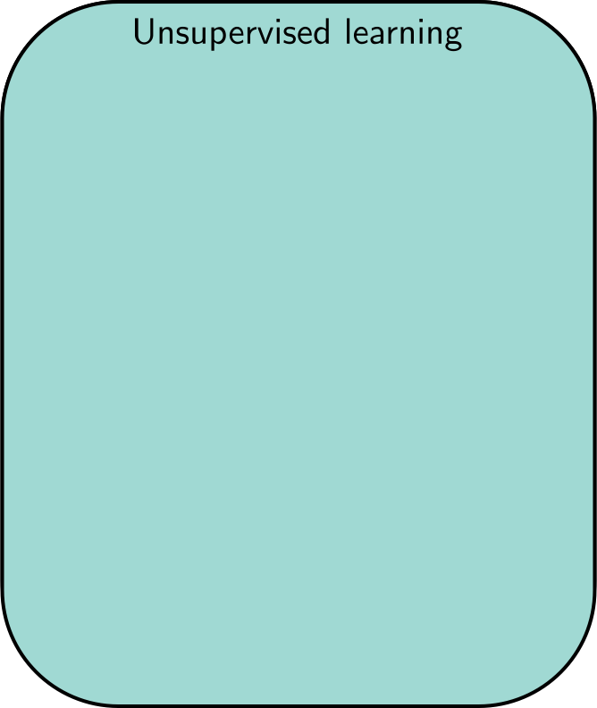
Unsupervised Learning
Learning about a dataset without labels
e.g., clustering

Slide 3
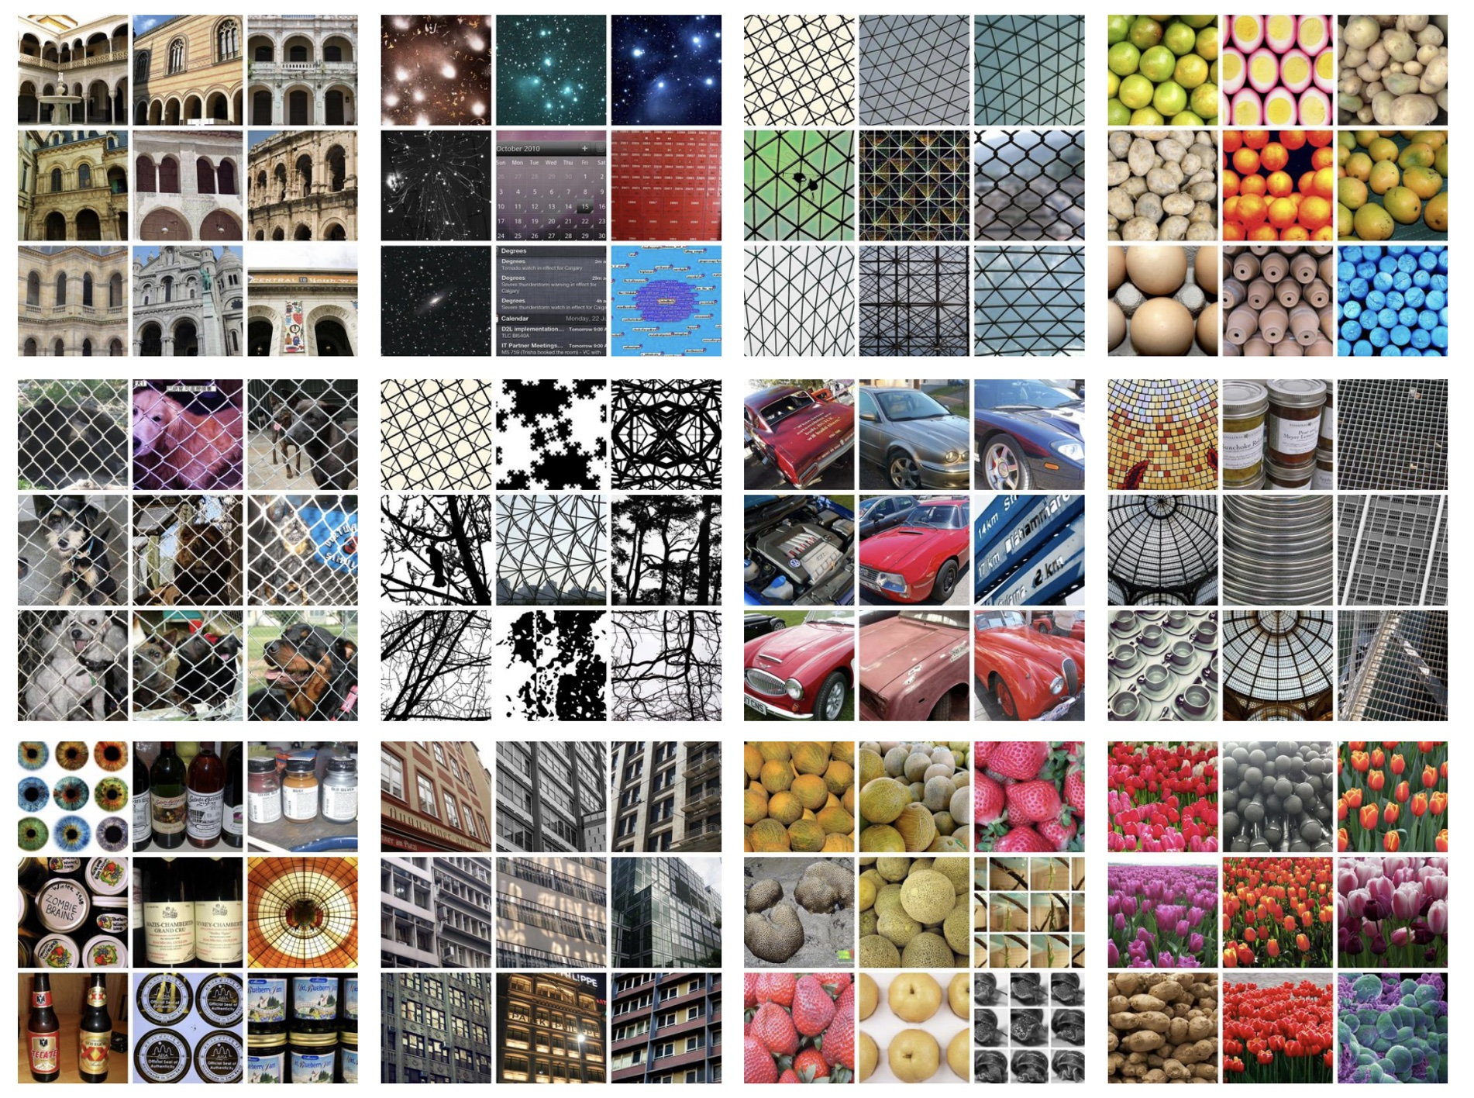
DeepCluster: Deep Clustering for Unsupervised Learning of Visual Features
Caron et al. (2018)

Slide 4
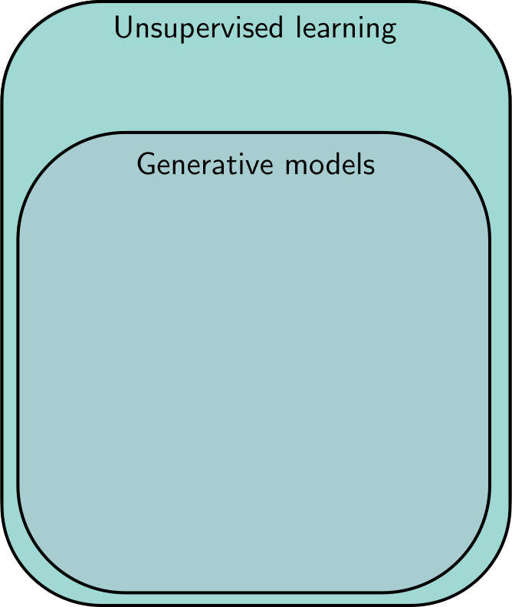
Unsupervised Learning
Learning about a dataset without labels
e.g., clustering
Generative models can create examples
e.g., generative adversarial networks

Slide 5
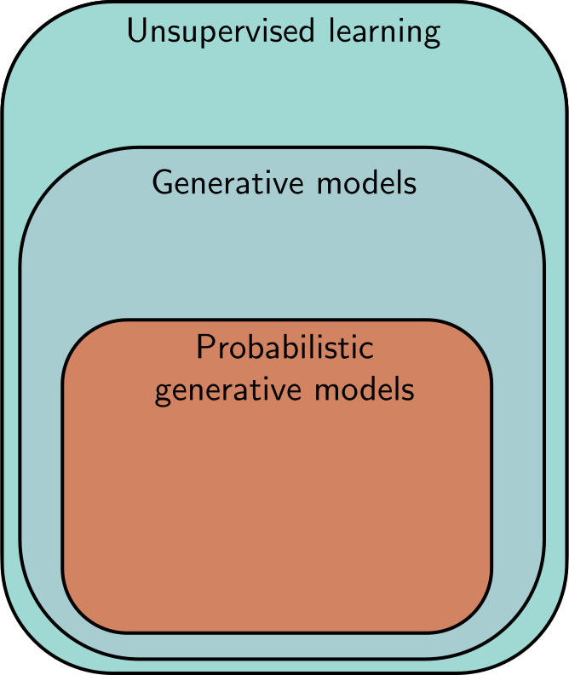
Unsupervised Learning
Learning about a dataset without labels
e.g., clustering
Generative models can create examples
e.g., generative adversarial networks
PGMs learn distribution over data
e.g., variational autoencoders,
e.g., normalizing flows,
e.g., diffusion models

Slide 6
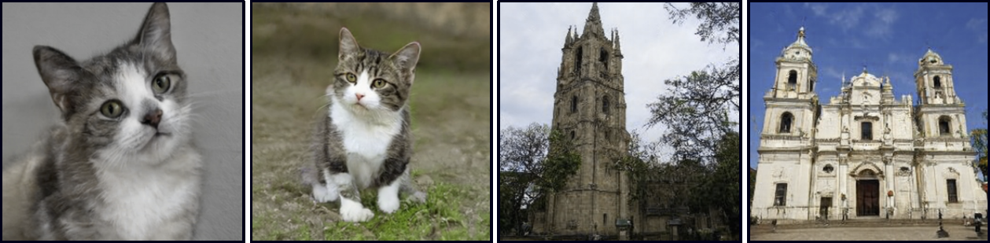
Synthesis

Slide 7
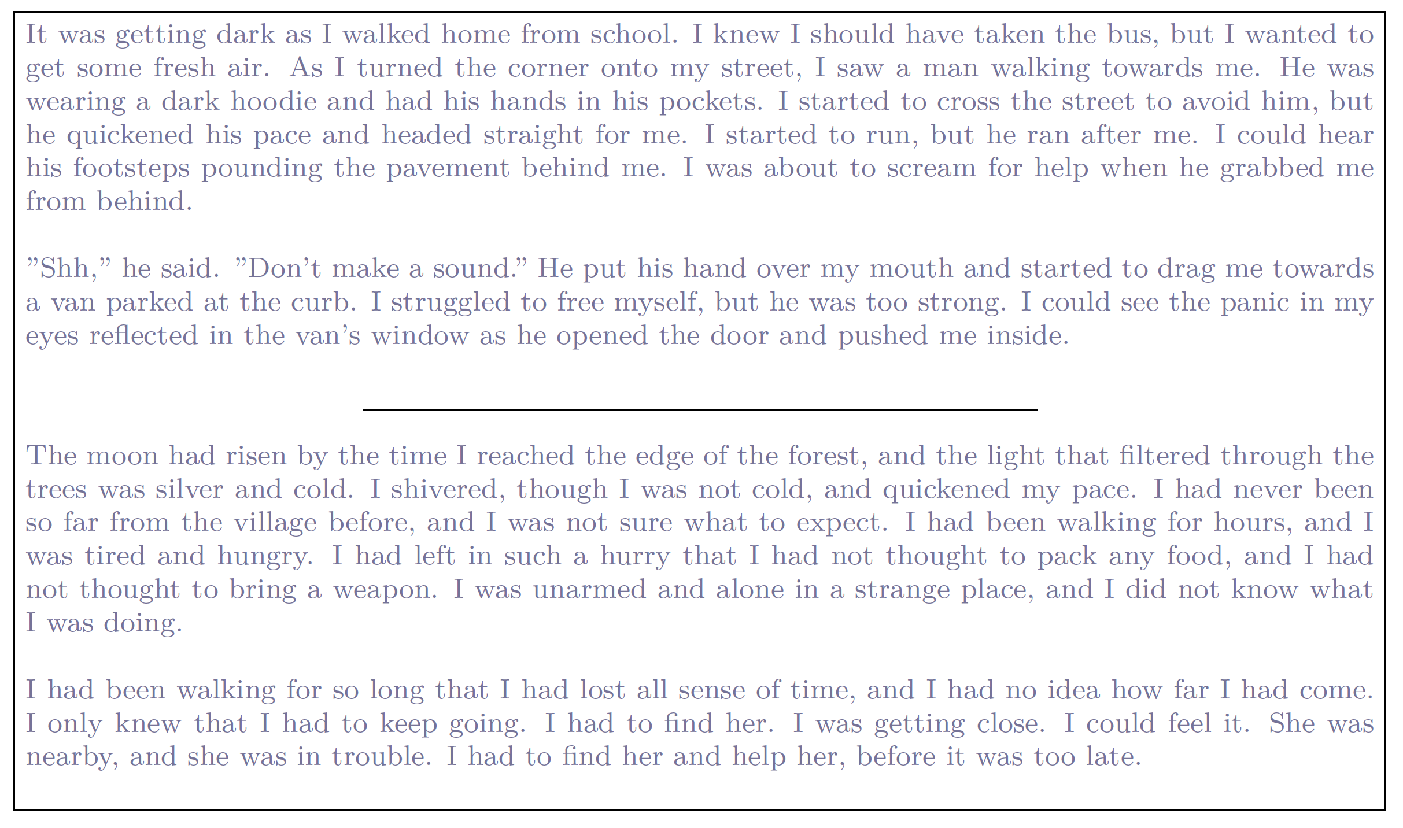
Synthesis

Slide 8
Latent variables

Slide 9
Why latent variables work

Slide 10
Latent variables - inversion

Slide 11
Interpolation

Slide 12
Latent variables - Inversion

Slide 13
Conditional synthesis

Slide 14
Conditional synthesis

Slide 15
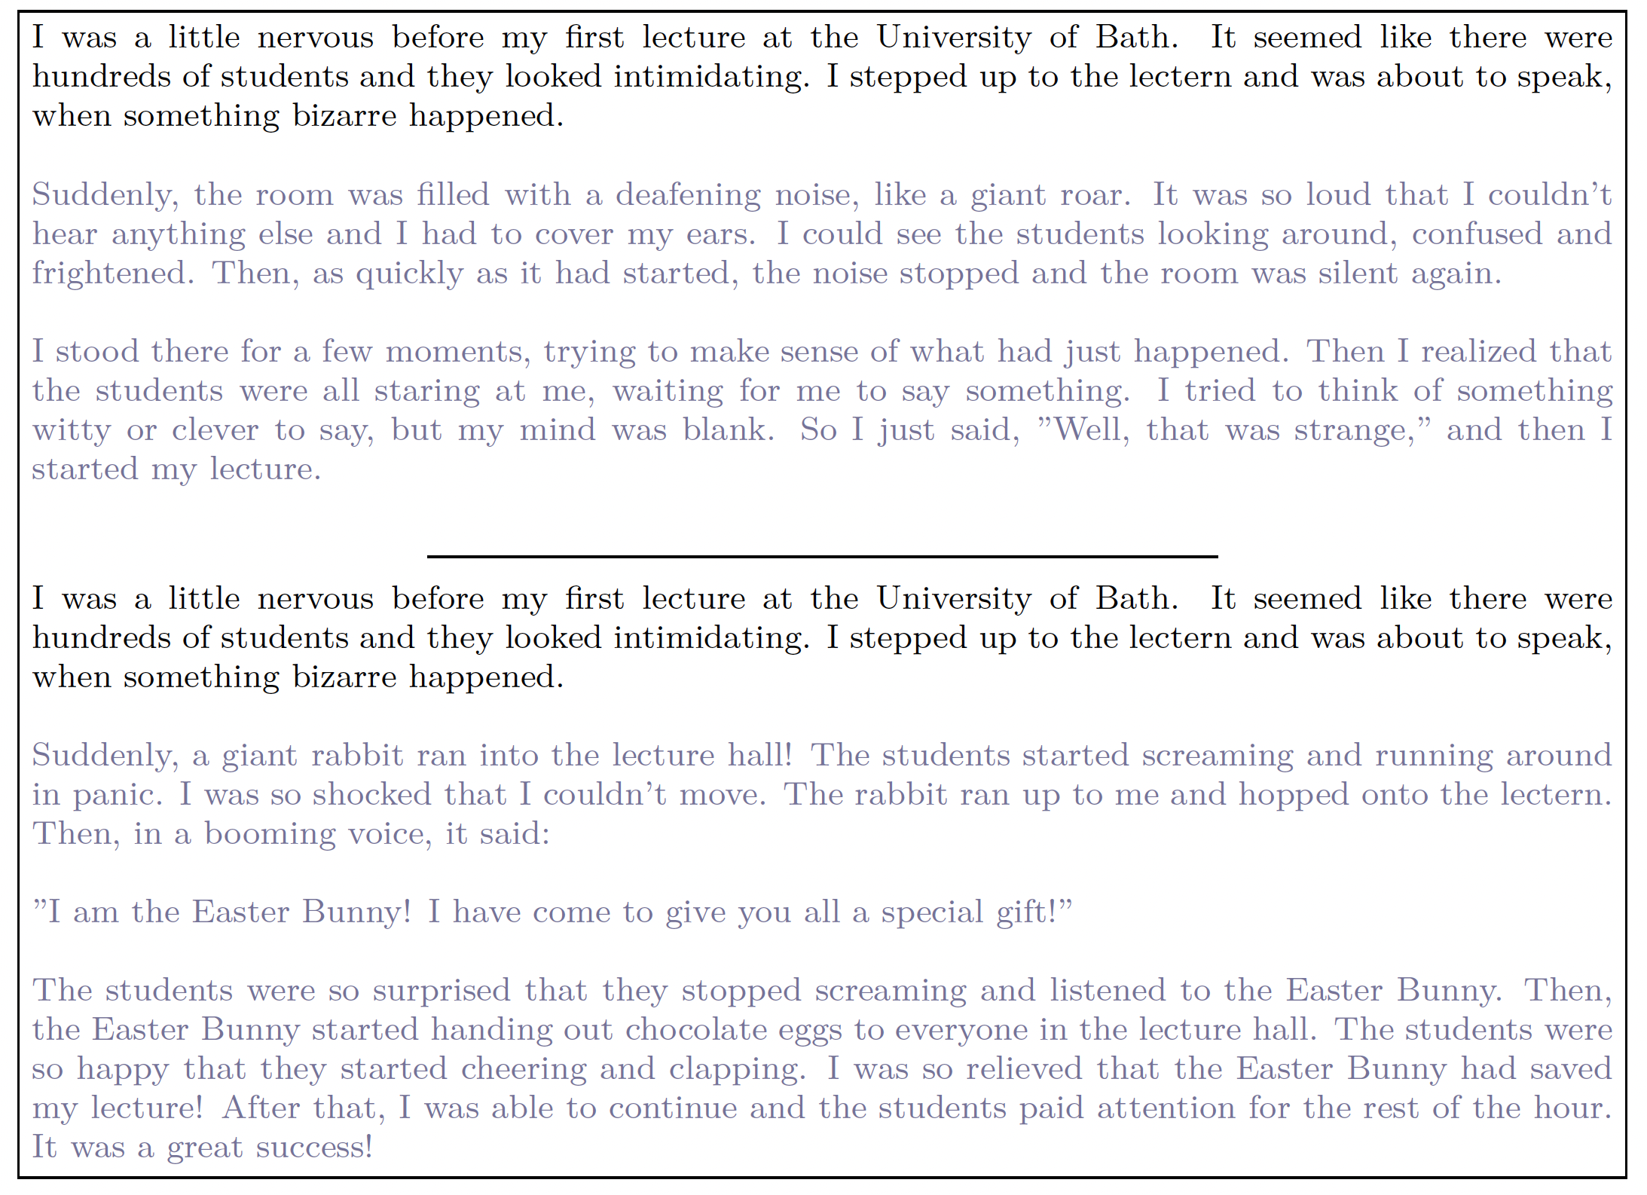

Slide 16
Connecting to supervised learning
A teddy bear on a skateboard in times square

Slide 17
Deep Learning
Supervised learning
Tasks
Models
Deep learning models
Unsupervised learning
Generative models
Probabilistic generative models
Latent variable models
Reinforcement learning

Slide 18
Reinforcement learning
A set of states
A set of actions
A set of rewards
Goal: take actions to change the state so that you receive rewards
Technically “Expected discounted future rewards”
e.g., chess
States are valid states of the chess board
Actions at a given time are valid possible moves
Positive rewards for taking pieces, negative rewards for losing them

Slide 19
Why is this difficult?
Stochastic
Make the same move twice, the opponent might not do the same thing
Rewards also stochastic (opponent does or doesn’t take your piece)
Temporal credit assignment problem
Did we get the reward because of this move? Or because we made good tactical decisions somewhere in the past?
Exploration-exploitation trade-off
If we found a good opening, should we use this?
Or should we try other things, hoping for something better?

Slide 20
Pacman example

Slide 21
Pacman example

Slide 22
Pacman example

Slide 23
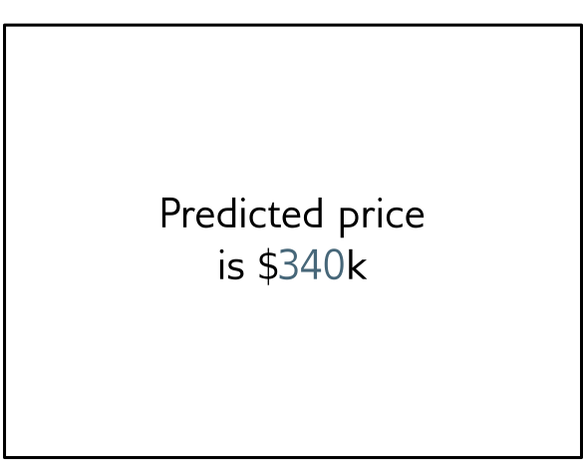
Policy learning
Action is move downward

Slide 24
Deep Learning
Supervised learning
Tasks
Models
Deep learning models
Unsupervised learning
Generative models
Probabilistic generative models
Latent variable models
Reinforcement learning

Slide 25
MAKE A GOOGLE/GMAIL ACCOUNT!

